Slide 1
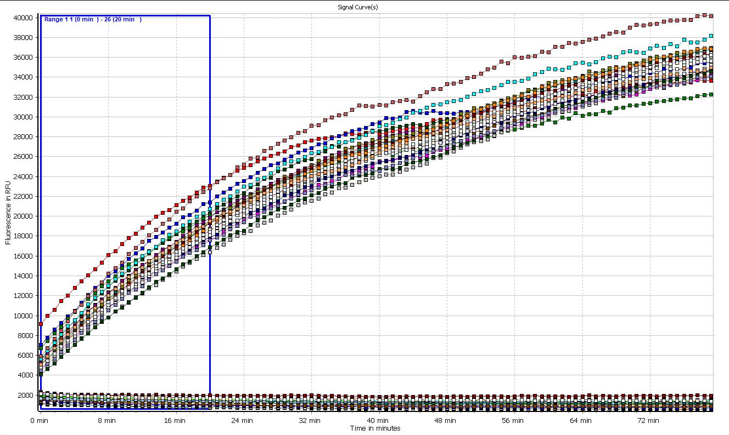

Slide 2
Compounds were tested as 12 concentration points starting from 200 uM final (1/2 dilutions) in the same assay buffer + substrate, no nsp15, read over time like reading nsp15 catalyzed reaction.
All the back-test samples are in the group of curves which are flat at the bottom. No change of signal is observed over time.
For comparison, the fluorescence signal gain curves are shown from the wells that contained the enzyme and were not inhibited.
Additionally nanoDSF data - it shifts the melting temp by +1.5 degrees C, meaning compound binds to the protein, was acquired for these compounds . Da tested it on native get - it does not alter the oligomeric state, so it is not an aggregator.

